Slide 1
Lecture 6: Functions and Recursion – Part I
Dr. Tsung-Wei Huang
Department of Electrical and Computer Engineering
University of Utah, Salt Lake City, UT
Notes:
Morning everyone
Today we are looking into control flow in C++.

Slide 2
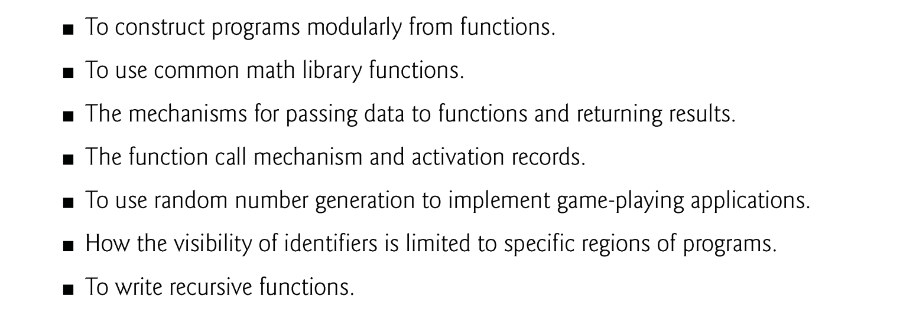
Learning Objective

Slide 3
Introduction
Construct programs from small, simple pieces, or components.
divide and conquer
We emphasize how to declare and use functions to facilitate the design, implementation, operation and maintenance of large programs.
You’ll learn how to declare your own functions.
We’ll discuss function prototypes and how the compiler uses them to ensure that functions are called properly.
We’ll take a brief diversion into simulation techniques with random number generation

Slide 4
Introduction
The C++ Standard Library provides a rich collection of functions for
common mathematical calculations,
string manipulations,
character manipulations,
input/output,
error checking and
many other useful operations.

Slide 5
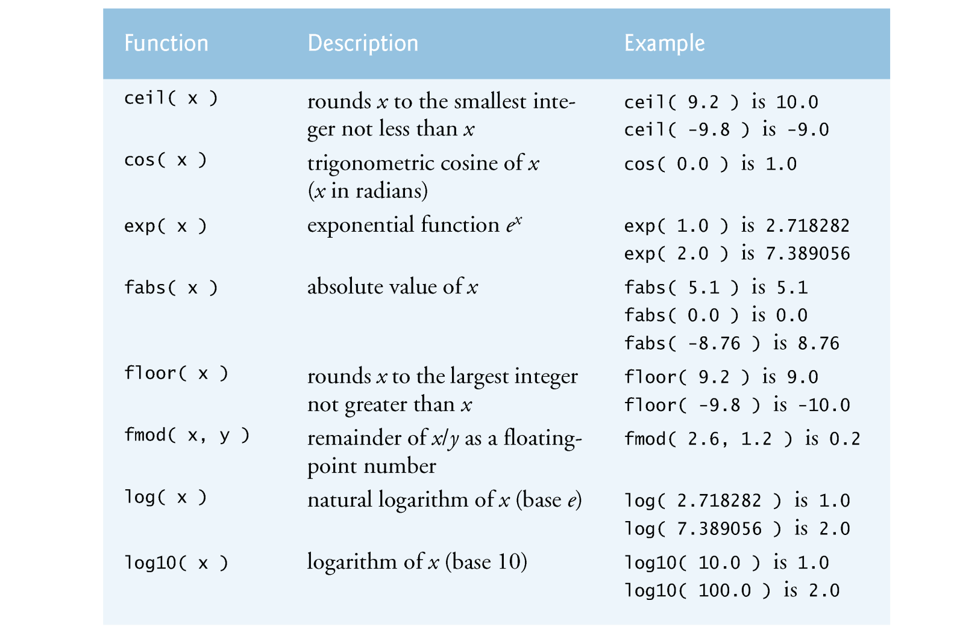
Math Functions in <cmath>

Slide 6
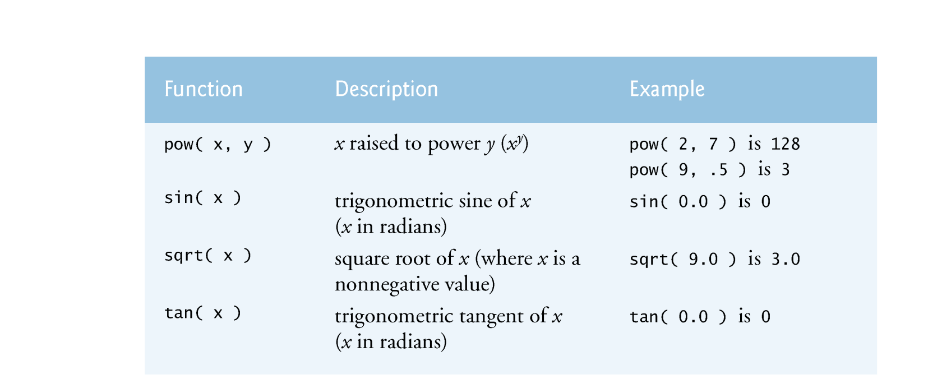
Math Functions in <cmath>

Slide 7
Introduction
Functions you write are referred to as user-defined functions or programmer-defined functions.
Motivations for “functionalizing” a program.
Divide-and-conquer makes program development more manageable.
Software reusability—using existing functions as building blocks to create new programs.
Programs can be created from standardized functions that accomplish specific tasks.
Avoid repeating code in a program.
Packaging code as a function allows the code to be executed from different locations in a program simply by calling the function.

Slide 8
Function Definition
The format of a function definition is as follows:
return-value-type function-name( parameter-list ) { declarations and statements }
The function-name is any valid identifier.
The return-value-type is the data type of the returned result to the caller.
The type void indicates that a function does not return a value.
All variables defined in a function are local variables—they’re known only in the function in which they’re defined.
Most functions have a list of parameters that provide the means for communicating information between functions.
A function’s parameters are also local variables of that function.

Slide 9
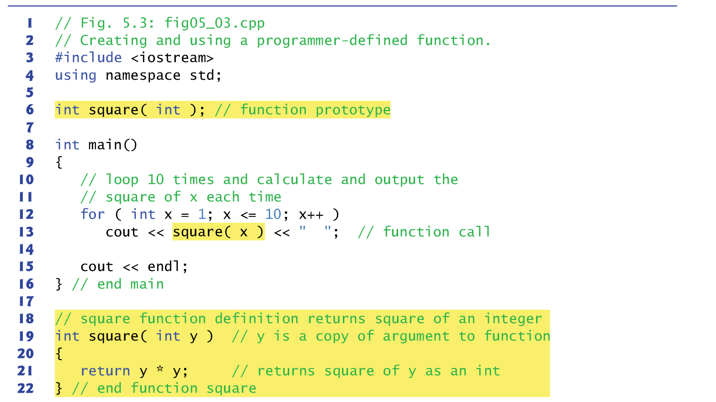
Example

Slide 10

Debrief
Function square is invoked or called in main with the expression square( x ) in line 13.
The parentheses () in the function call are an operator in C++ that causes the function to be called.
Function square (lines 19–22) receives a copy of the value of argument x from line 13 and stores it in the parameter y.
Then square calculates y * y (line 21) and passes the result back to the point in main where square was invoked (line 13).
The result is displayed.
The function call does not change the value of x.
The for repetition structure repeats this process for each of the values 1 through 10.

Slide 11
Debrief
The definition of square (lines 19–22) shows that it uses integer parameter y.
Keyword int preceding the function name indicates that square returns an integer result.
The return statement in square (line 21) passes the result of the calculation back to the calling function.

Slide 12
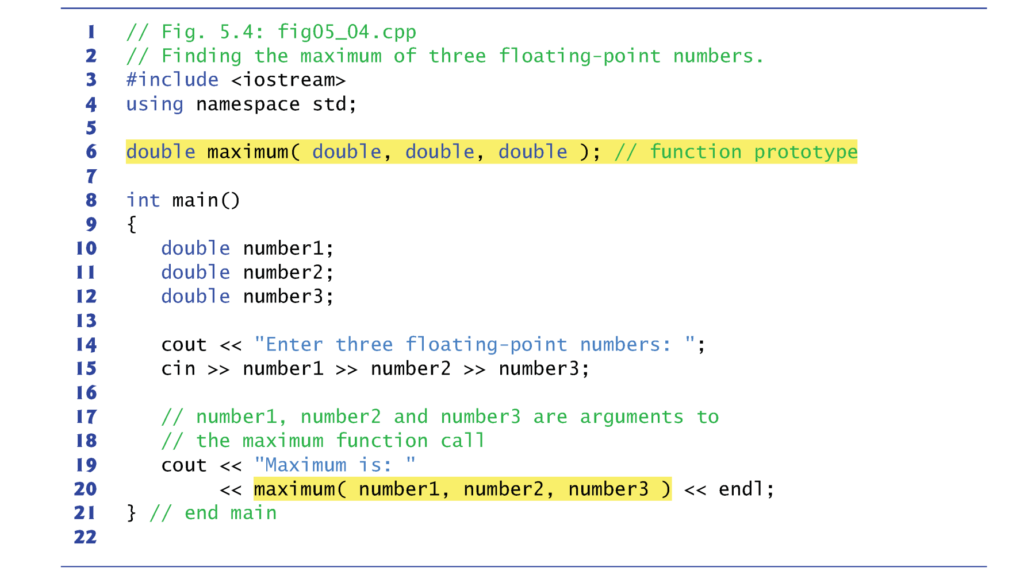
Function With Multiple Arguments

Slide 13
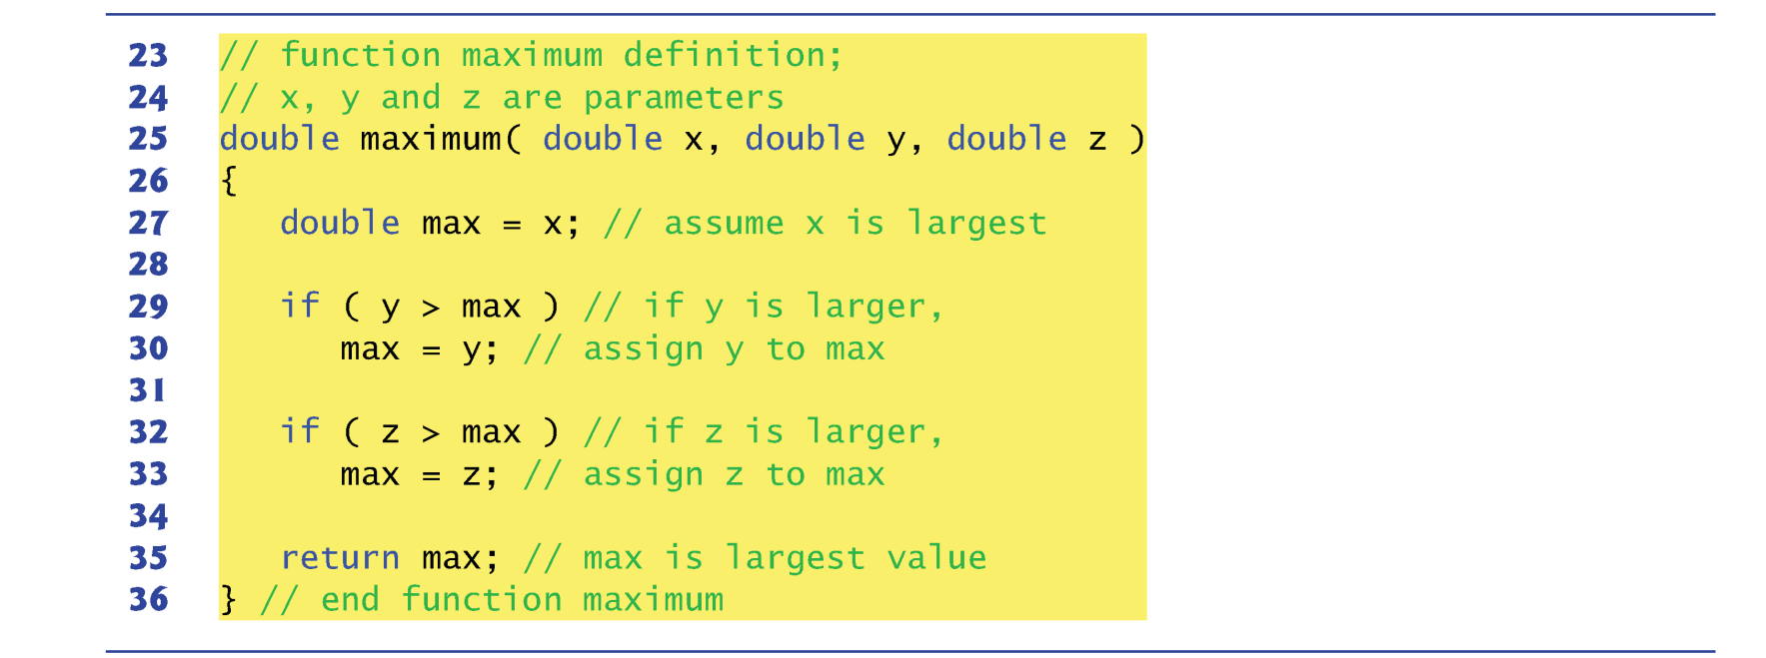
Function with Multiple Arguments

Slide 14
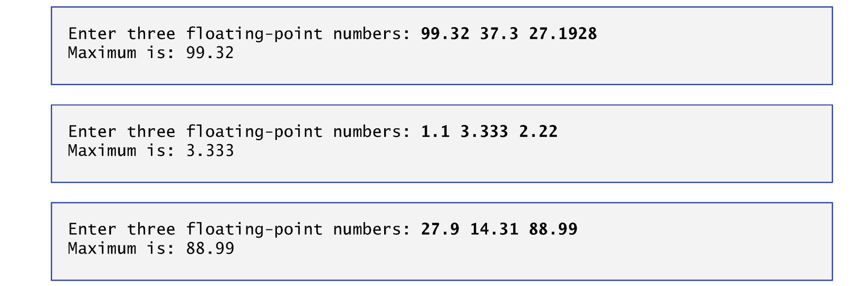
Function with Multiple Arguments

Slide 15
Case Study: Random Number Generator
The element of chance can be introduced into computer applications by using the C++ Standard Library function rand.
The function prototype for the rand function is in <cstdlib>.
For example: i = rand();
Function rand generates an unsigned integer between 0 and RAND_MAX (a constant defined in the <cstdlib> header file).
For GNU C++, the value of RAND_MAX is 2147483647; for Visual Studio, the value of RAND_MAX is 32767.
To produce integers in the range 0 to 5, we use the modulus operator (%) with rand as follows → rand() % 6
The number 6 is called the scaling factor.
Shifting the range of numbers produces the integers from 1 to 6.
1 + rand() % 6

Slide 16
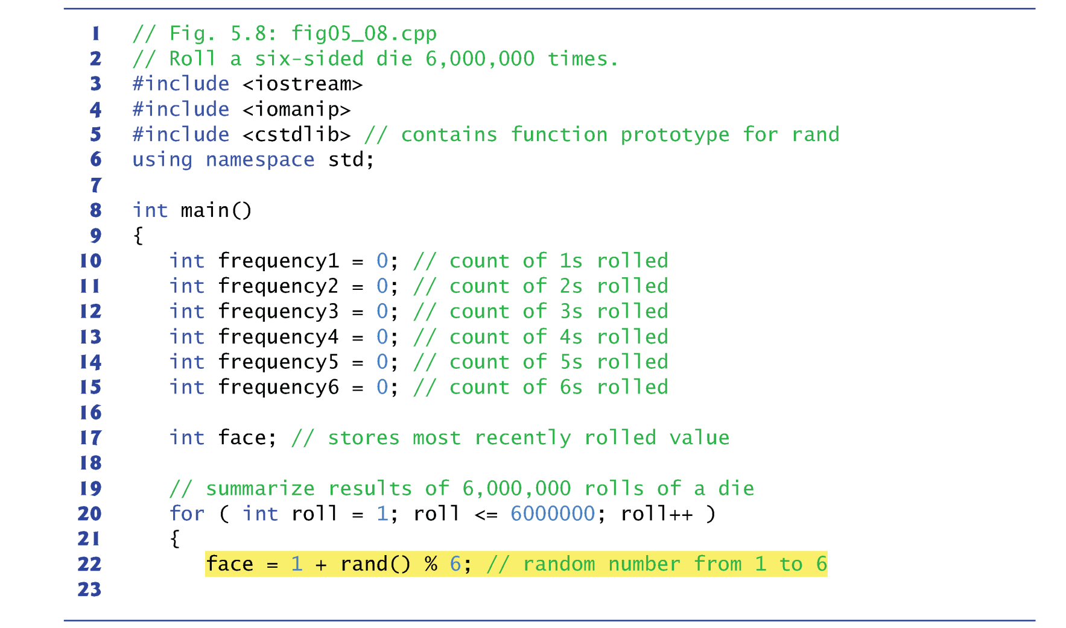
Case Study: Random Number Generator

Slide 17
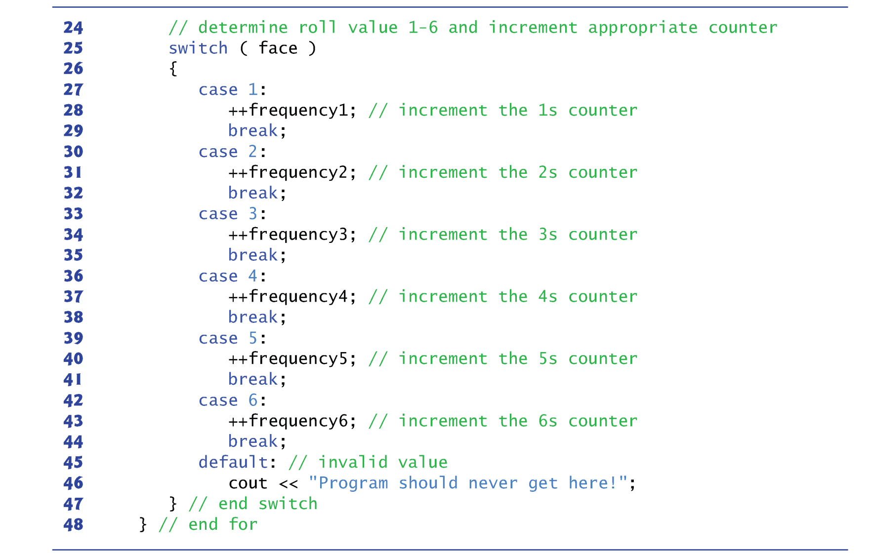
Case Study: Random Number Generator

Slide 18
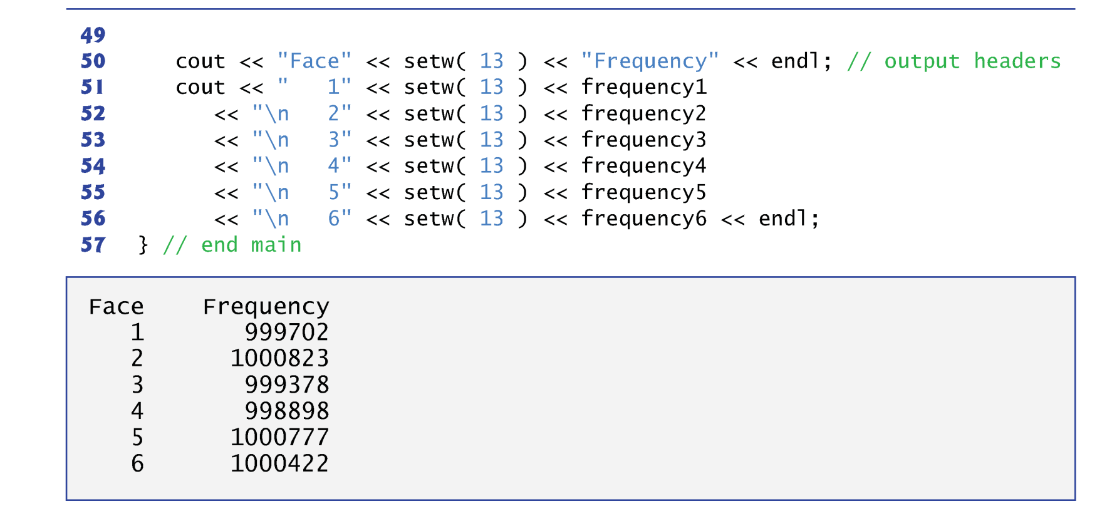
Case Study: Random Number Generator

Slide 19
True Randomness …?
Function rand actually generates pseudorandom numbers.
The numbers in the sequence appear to be random, but the sequence repeats itself each time the program executes.
It can be conditioned to produce a different sequence of random numbers for each execution.
This is called randomizing and is accomplished with the C++ Standard Library function srand.
Function srand takes an unsigned integer argument and seeds the rand function to produce a different sequence of random numbers for each execution.
The function prototype for srand is in header file <cstdlib>.

Slide 20
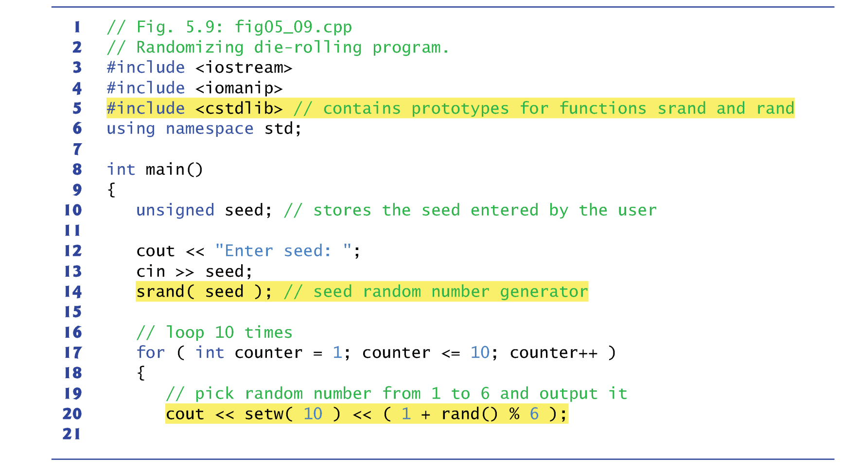
True Randomness …?

Slide 21
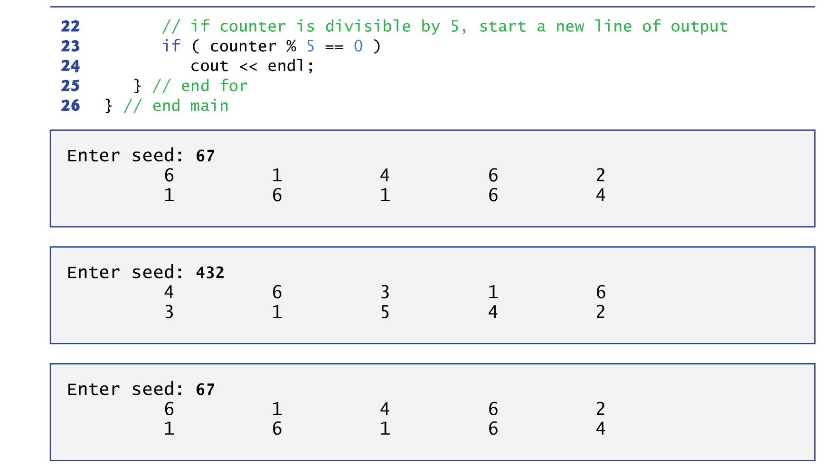
True Randomness …?

Slide 22
Practical Use of Seed
To randomize without having to enter a seed each time, we may use a statement like
srand( time( 0 ) );
This causes the computer to read its clock to obtain the value for the seed.
Function time (with the argument 0) typically returns the current time as the number of seconds since January 1, 1970, at midnight Greenwich Mean Time (GMT).
This value is converted to an unsigned integer and used as the seed to the random number generator.
The function prototype for time is in <ctime>.

Slide 23
Summary
Function
Function with Multiple Arguments
Case Study: Random Number Generator

Slide 24
LAB
Write a function “is_prime” that
Takes an positive integer N
Returns “true” if N is a prime or “false”
In the main function, write a for loop that
Loops from 2 to 1000
Call the function “is_prime” at each iteration to check if the number is a prime
Prints all prime numbers in the range [2, 1000]

